Slide 1
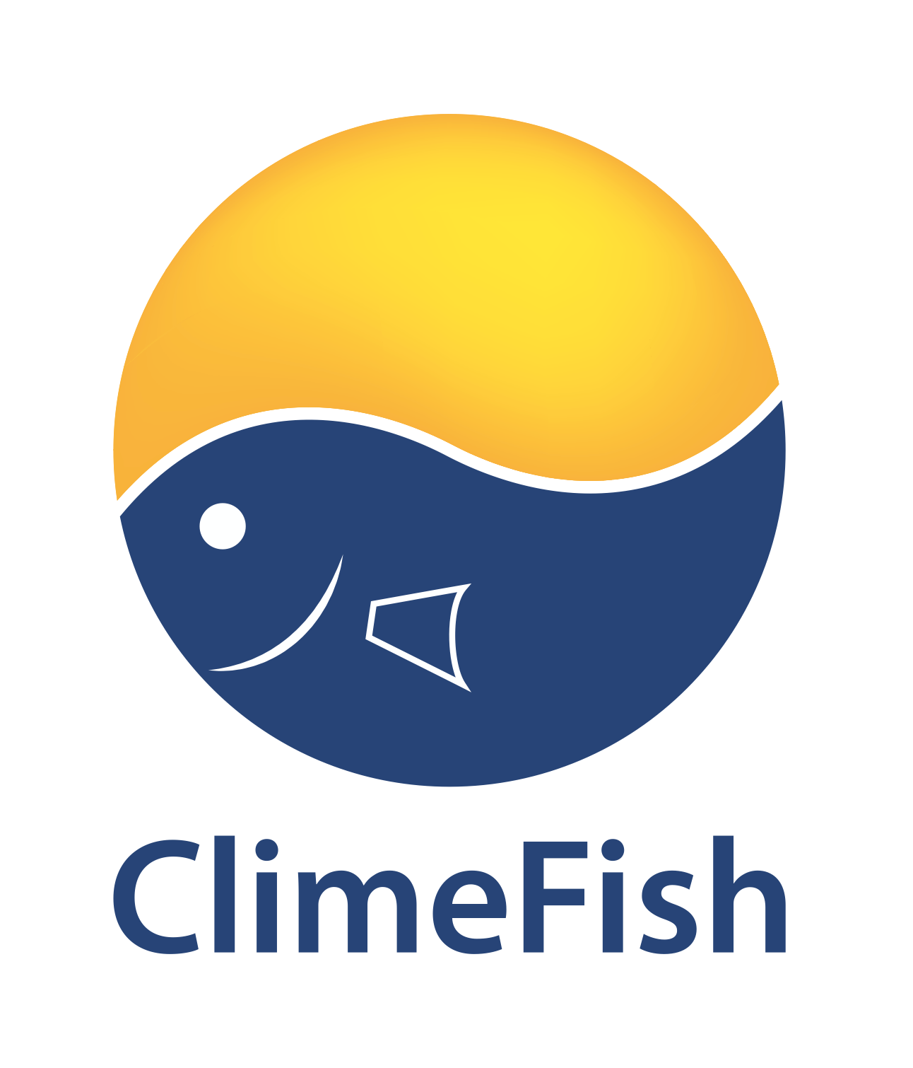
Adaptation to climate change in fisheries
How do we prepare for the impacts of climate change within fisheries?
ACAF Networking webinar on Arctic climate change adaptation
3rd June 2021
Ragnhildur Friðriksdóttir
Project Manager at Matís, Iceland

Slide 2
What is happening in our oceans?
40%
25%
93%

Slide 3
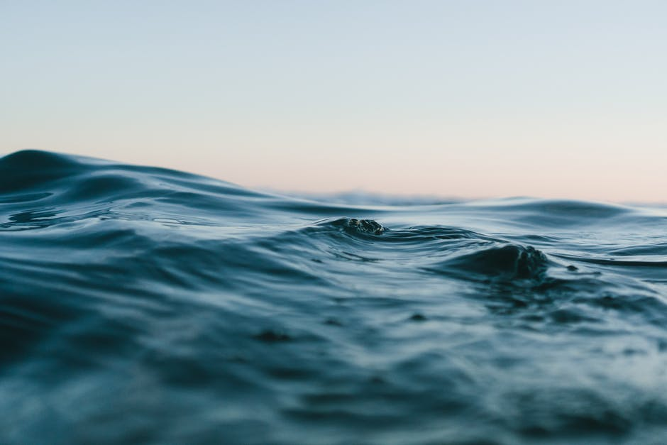
Example of impacts of climate change on marine environment and marine life
Increased temperature and ocean acidification
Special concern for Northern and Arctic regions
Changes in ocean currents and circulation
Shifts in fish distribution and migration behaviour
Changes in stock sizes
Changes in growth rates and age of maturity
Changes in marine food webs and food availability
Extreme weather events
Sea level rise

Slide 4
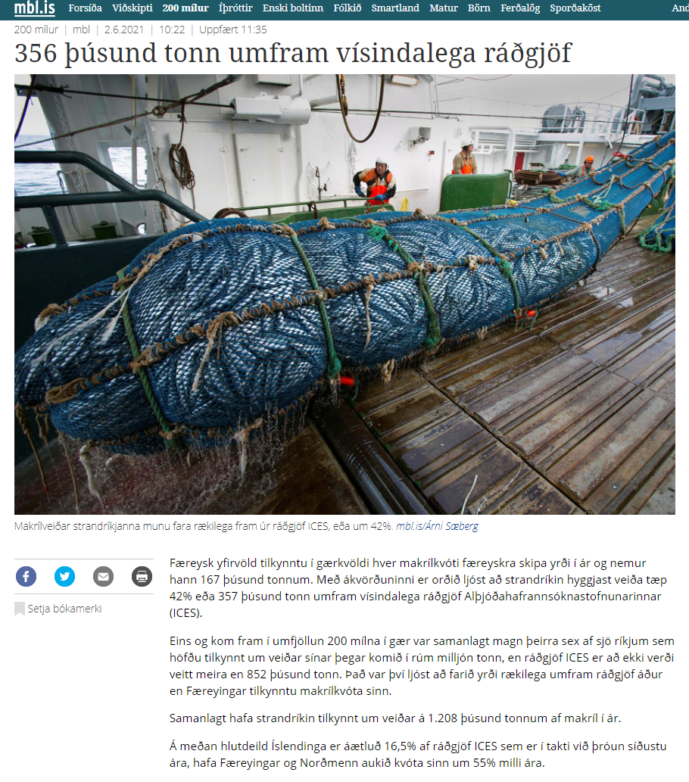
Potential impacts on fisheries
Models suggest a decrease in maximum catch potential
Some areas will see an increase, while others will have decrease
Increased complexity in negotiating catch quotas
More challenging conditions at sea
Increase risk for fishers – damages to infrastructure – fewer days at sea
Changes in catch composition (species composition, age/size composition)
Species come and species go

Slide 5
What about Iceland?
Stock size changes in capelin, mackerel, cod and sand eel
Decrease in seabird populations
Changes in migration patterns of mackerel, haddock and monkfish
Dilemma in negotiations on quota for shared species
Notes:
Iceland is currently one of very few countries in Europe that have not yet produced a national adaptation strategy.

Slide 6
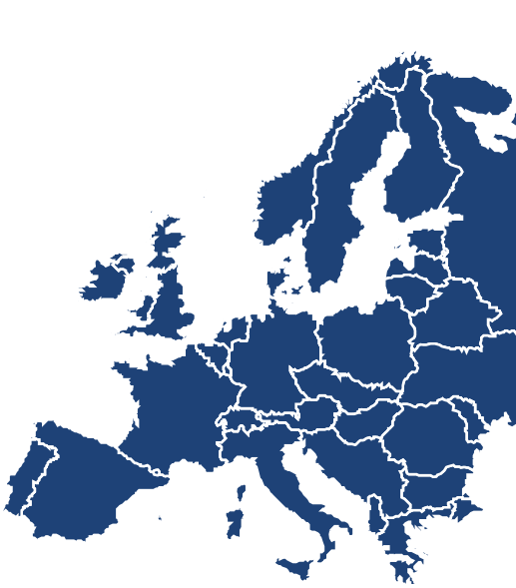
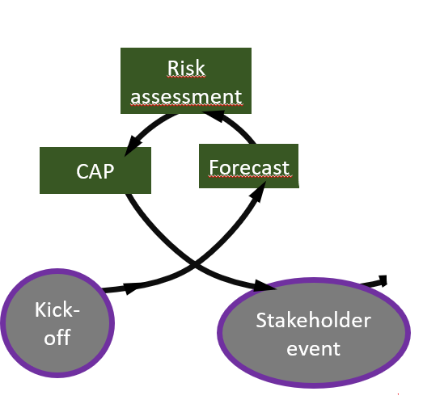
ClimeFish Case Studies in 3 sectors
16
4
Forecasting
Risk assessments
Climate adaptation plans
7
1
11
Bo
Fisheries
Aquaculture
Lakes and ponds
2
C5F
5
14
C14
3
C9F
9
C10
10
C8F
8
C6F
C13
6
13
C15A
15
C12A
12

Slide 9
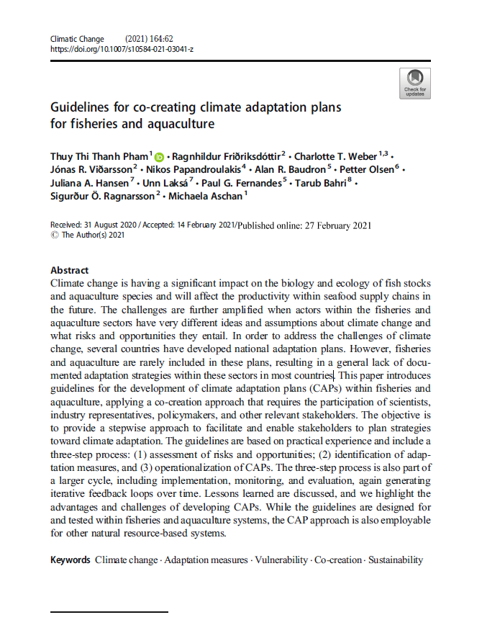
International standard - Guidelines for creating Climate Adaptation Plans (CAPs)
CEN Workshop Agreement CWA 17518:2020
Good practice recommendations for making Climate Adaptation Plans for fisheries and aquaculture
Evaluate current status
Forecasts
Risk assessment
Outcomes
Main risks and opportunities
Main vulnerabilities
Adaptation measures
and trade-offs
Implementation plan for adaptation measures
Assess risks and opportunities
1
Identify adaptation measures
2
Vulnerability assessment
Adaptation needs
Adaptation measures
Operationalize CAPs
3
Implementation plan
Pham et al. Climatic Change 2021
Notes:
One of the

Slide 10
Thank you!
Takk fyrir mig!
Notes:
Þetta þarf allt að meta á þessu stigi, því þættir eins og til dæmis of hár kostnaður getur orðið til þess að ákveðin aðlögunaraðgerð telst ekki lengur fýsileg.

Slide 11
Examples of adaptation measures
Revise the governance of transboundary fish stocks and system allocating fishing rights
Development of more robust fishing gear / more selective fishing gear
Improved monitoring / new monitoring programmes
More robust infrastructures and improved monitoring of these
Both at sea and on land
Changes in marketing → marketing of new species, entering new markets, revising marketing strategies
Measures to improve safety on board (infrastructure, capacity building and education, safety equiment, forecasts)
Reduce other pressures on the marine ecosystem → e.g. improved management, less pollution
Investments in “climate smart” infrastructures
Revisions of legal frameworks to enable effective adaptation measures

