Slide 1


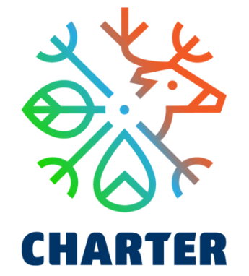
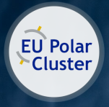
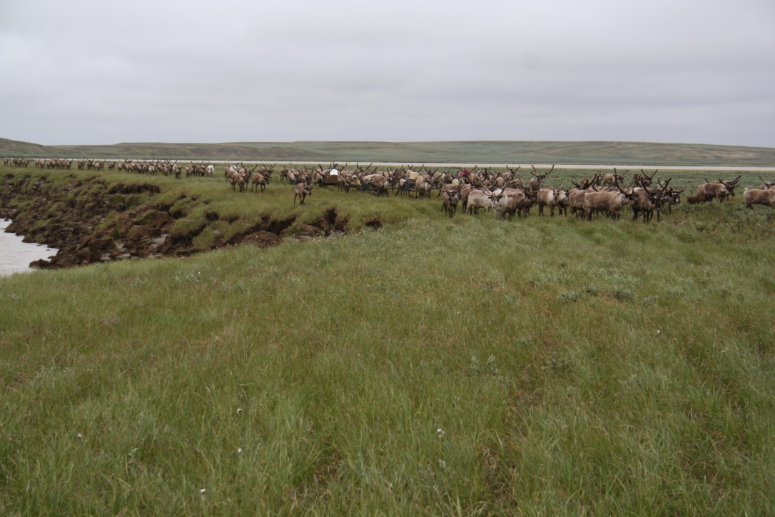
Climate Adaptation Issues in Arctic Russia: Rain-on-Snow
Prof. Bruce C. Forbes
Arctic Centre, University of Lapland
Tundra Nenets migration, Yamal, West Siberia. Photo: B.C. Forbes

Slide 2

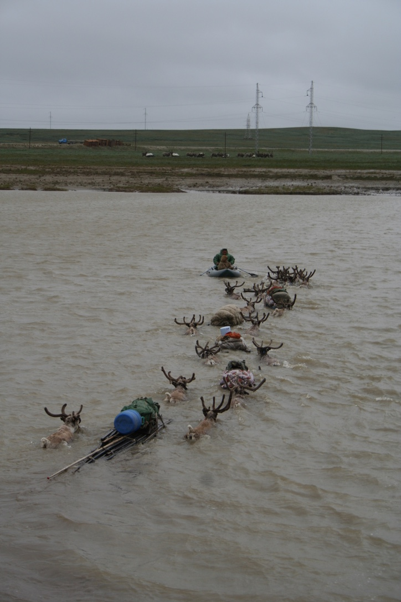

Consortium
9 European countries (+ Russia, China)
21 Research Institutions
7 Work Packages
Coordinator
Arctic Centre
University of Lapland
Finland
Duration
08.2020 – 07.2024
Budget
5.9 M Euro
CHARTER wants to advance the capacity of Arctic communities to adapt to climate and biodiversity changes. CHARTER has three main aims:
Better understand past and ongoing responses of Arctic terrestrial social-ecological systems to changes in biodiversity, snow and ice cover across decades and centuries
Simulate future effects of social-ecological changes for indigenous and local communities and traditional livelihoods out to 2050
Work with Arctic communities to co-develop strategies and policy pathways for livelihoods such as reindeer herding, hunting and fishing
Photo: B.C. Forbes
www.charter-arctic.org
@CharterArctic

Slide 3
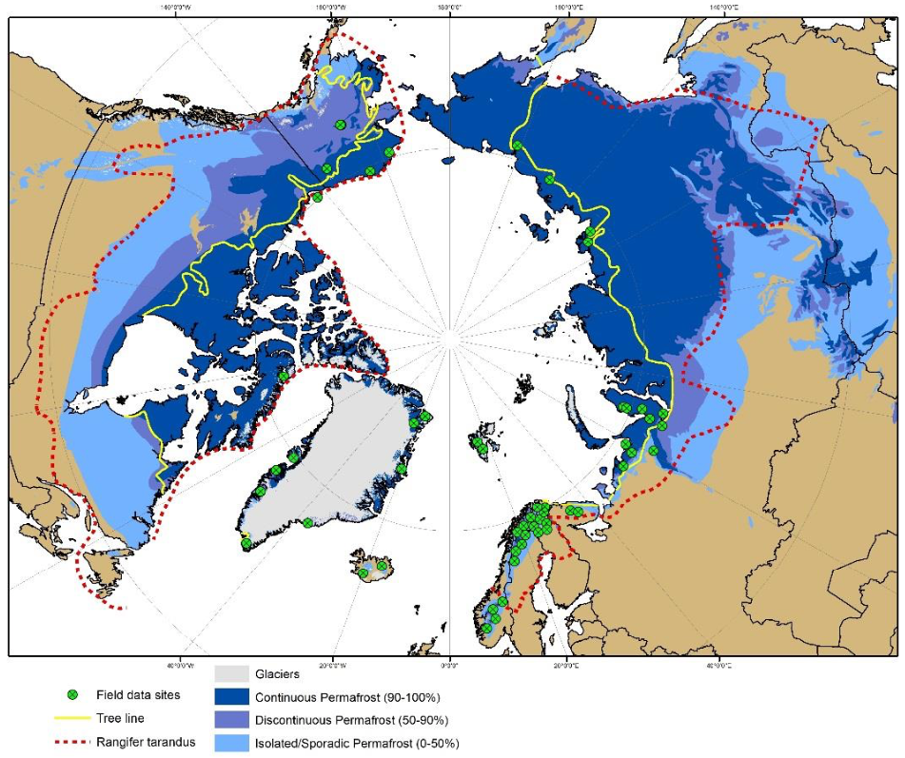
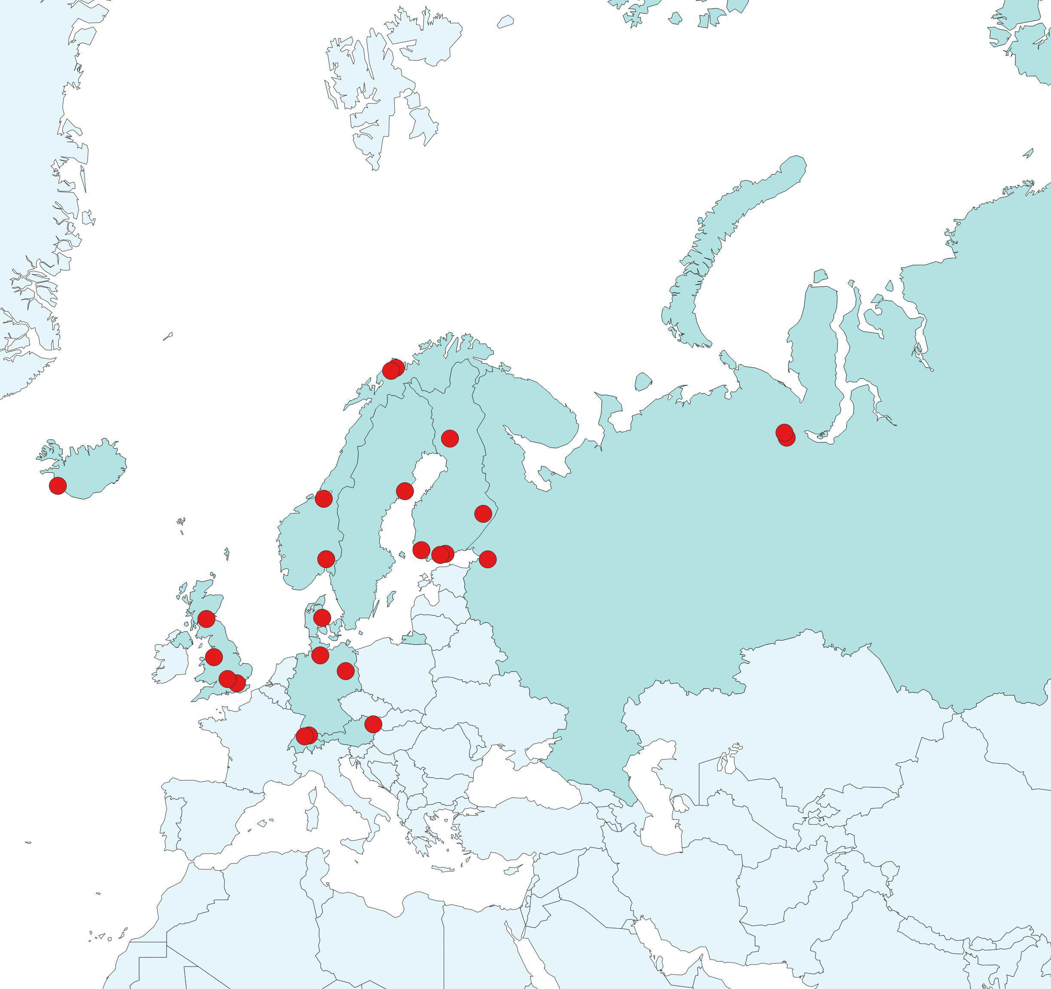
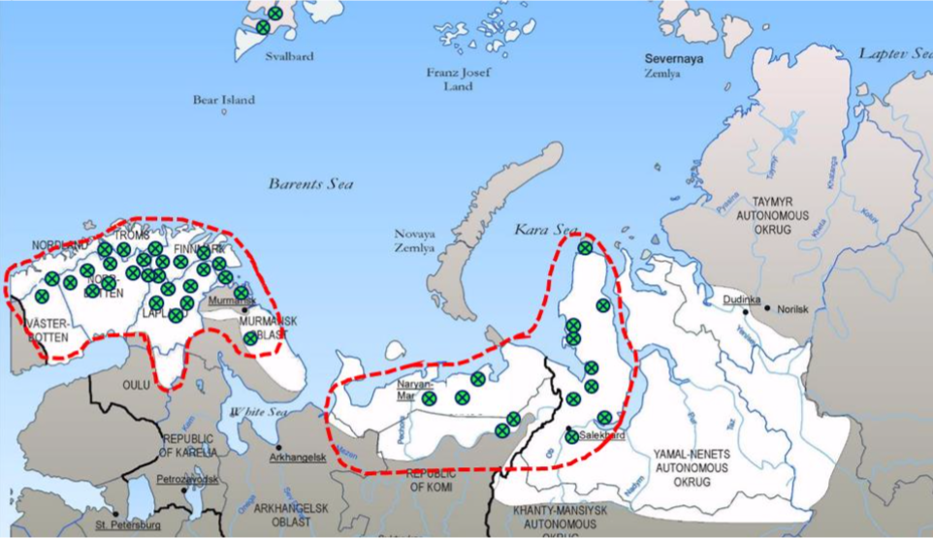
CHARTER partners, regions and datasets
The CHARTER
consortium
Reindeer herding areas (in white) comprise the core study region of CHARTER. Focal sub-regions are highlighted (in red). Green dots mark CHARTER field study sites.

Slide 4
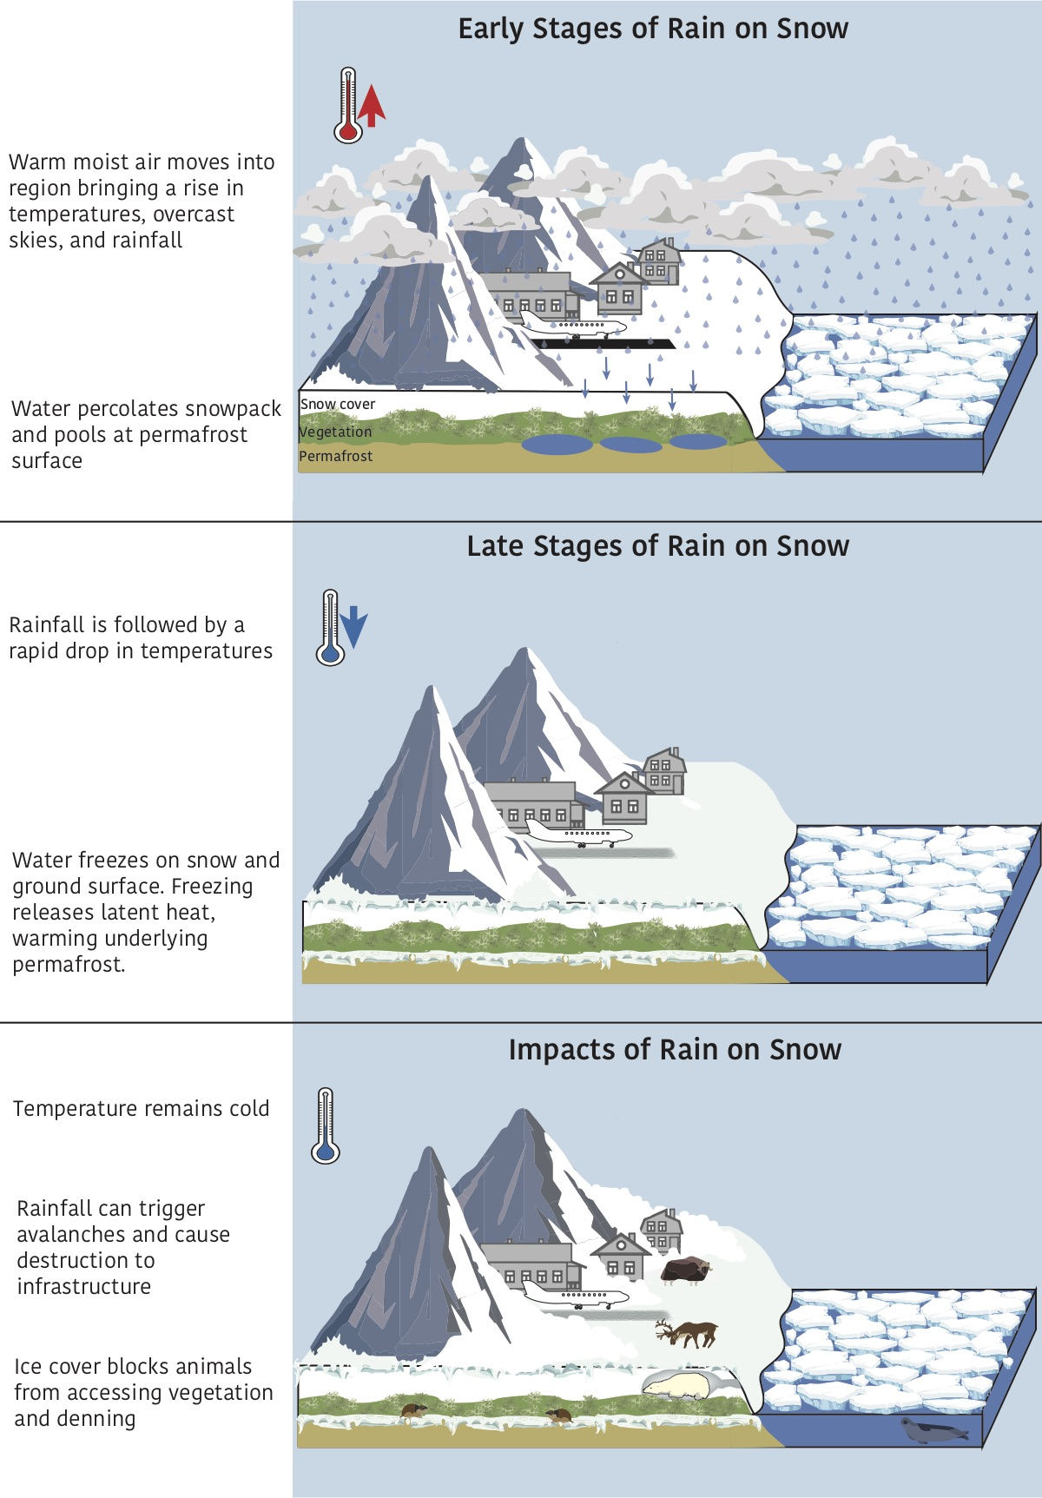
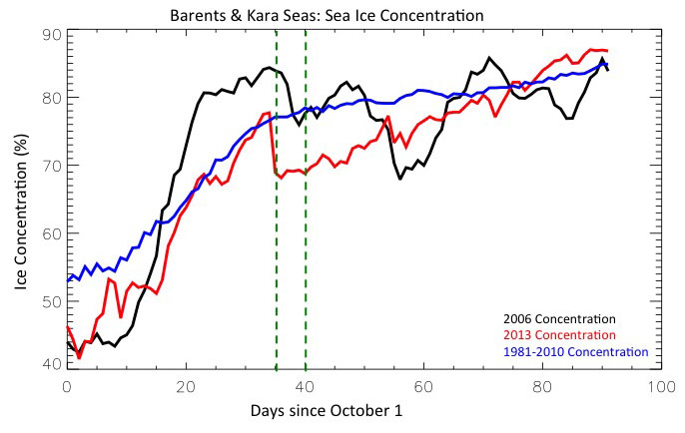
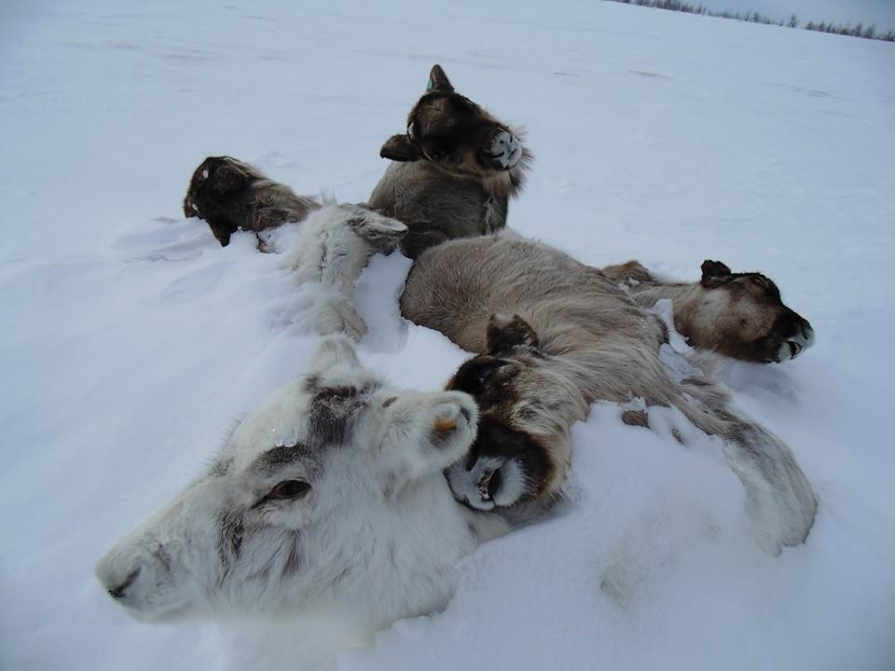
CHARTER aims at integrating
knowledge across multiple time and
spatial scales (local to circumpolar and
late Holocene out to 2050).
Forbes, B.C. et al. (2016) Biology Letters
Photo: R. Serotetto
Serreze et al. (submitted)

Slide 5
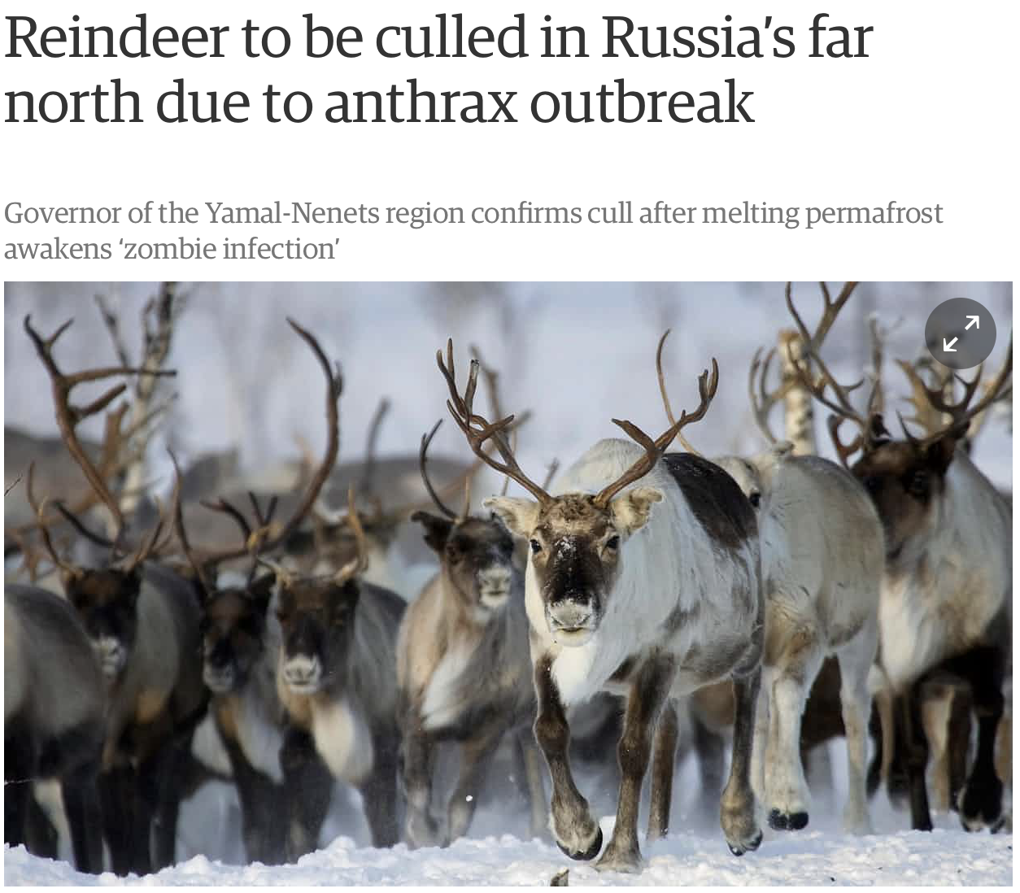
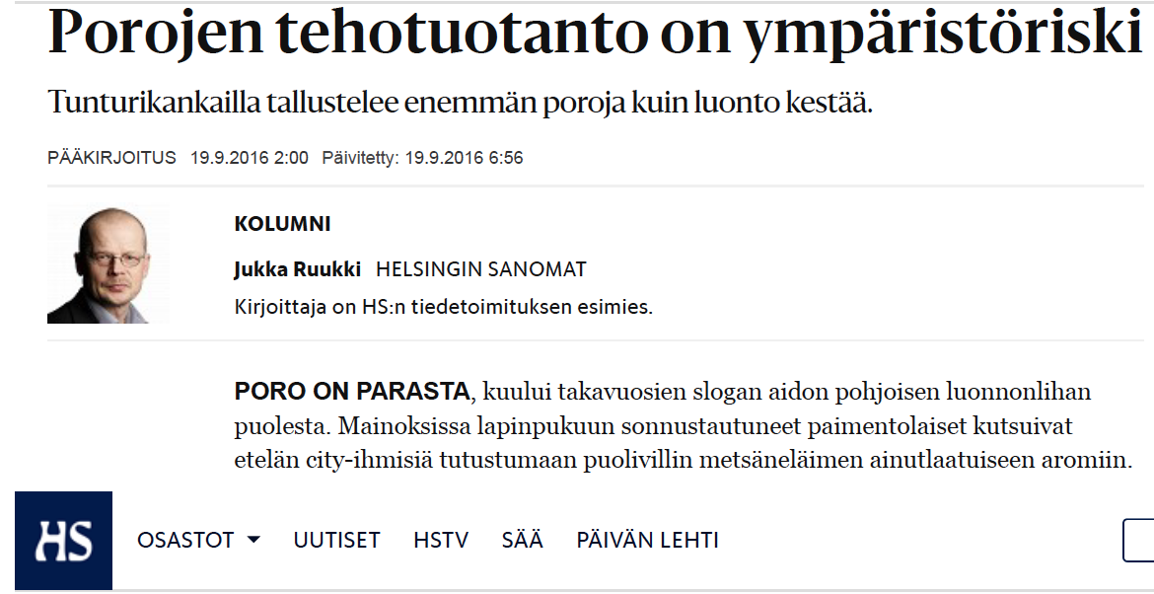


The “overgrazing” narrative in both northern Fennoscandia and Russia overrides urgently needed discussion of biodiversity, climate change and adaptation
(Reindeer factory farming is an environmental risk)

Slide 6
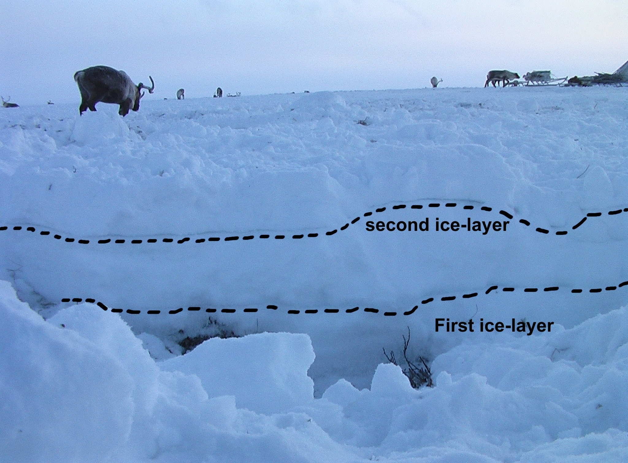
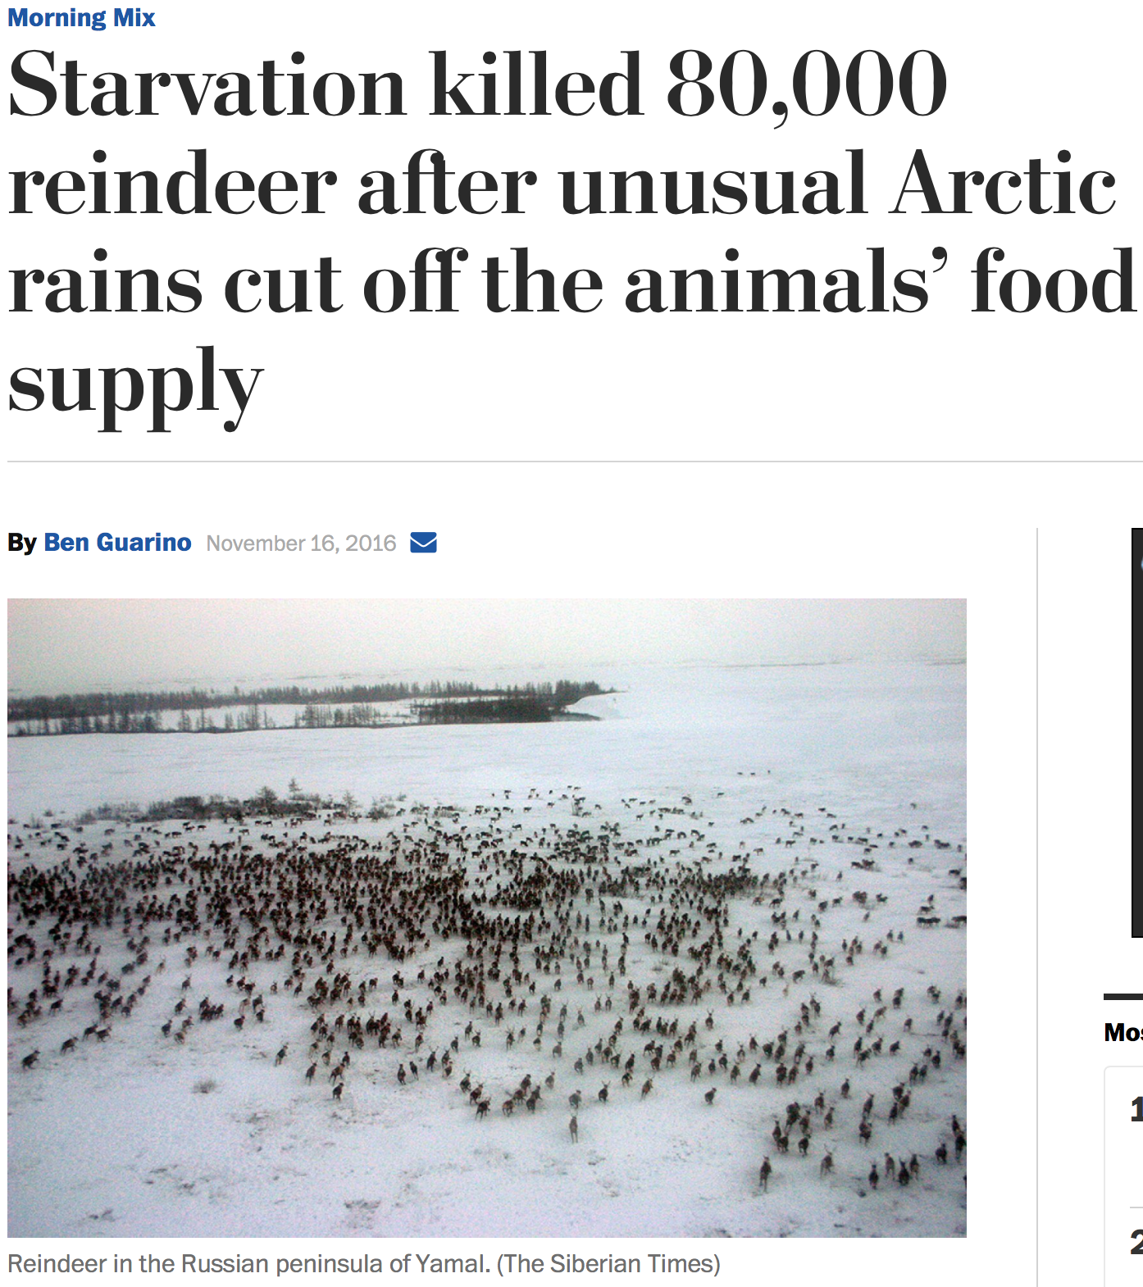

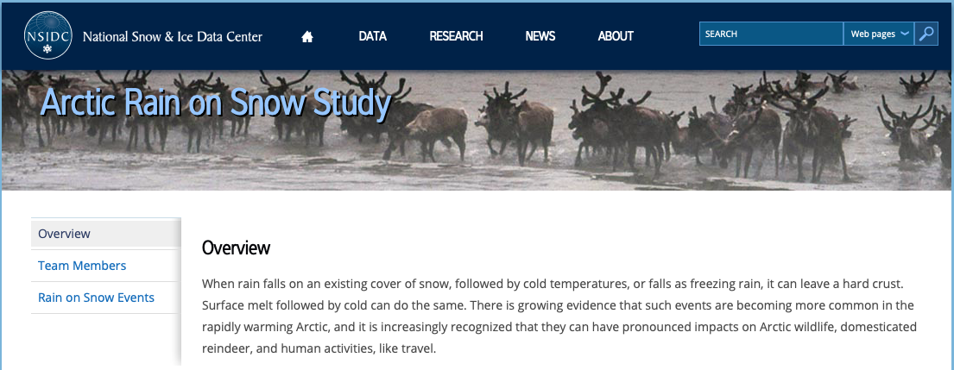
Partnerships with EU and US-funded projects
Two layers of ice in snow, Yamal
https://nsidc.org/rain-on-snow
Photo: Florian Stammler

Slide 7
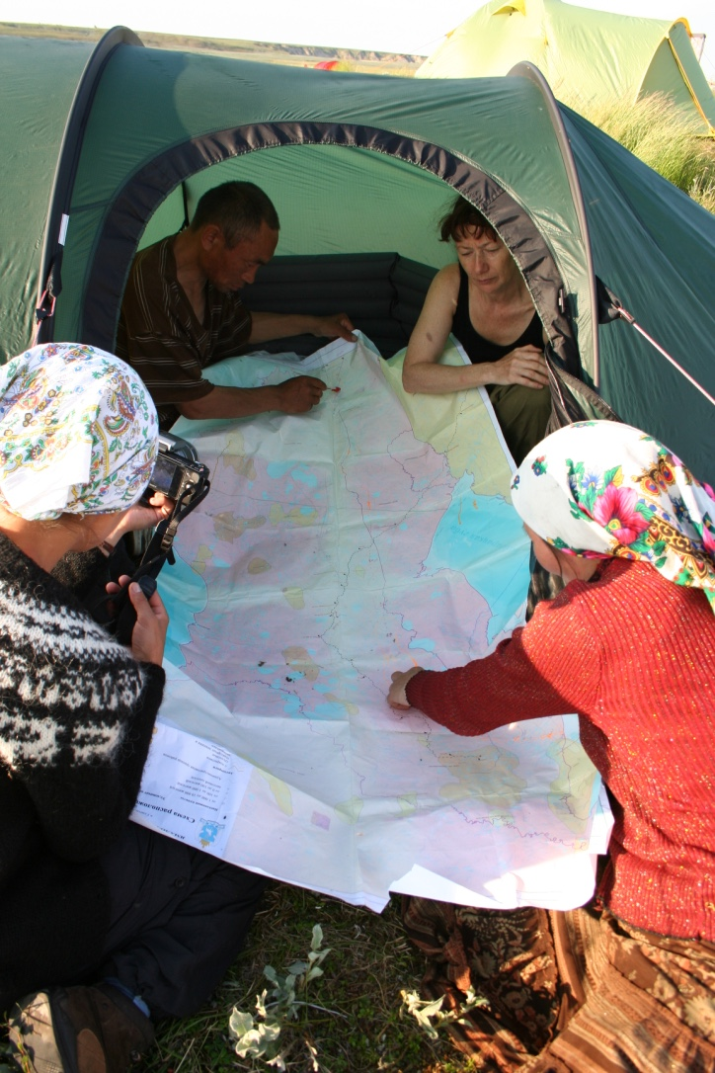
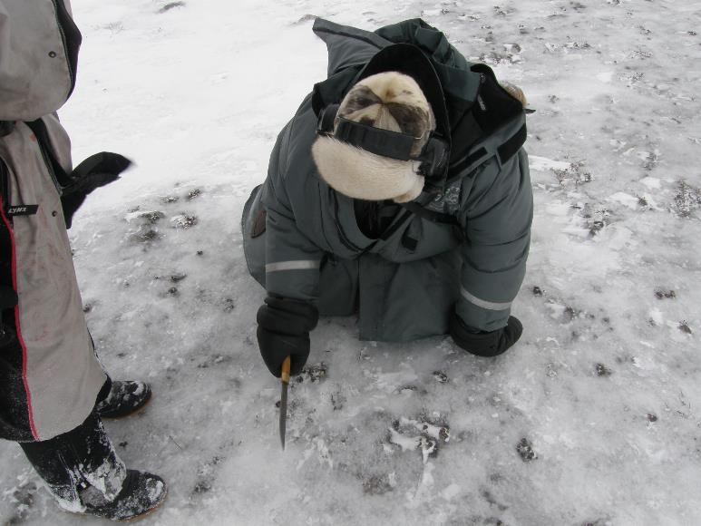
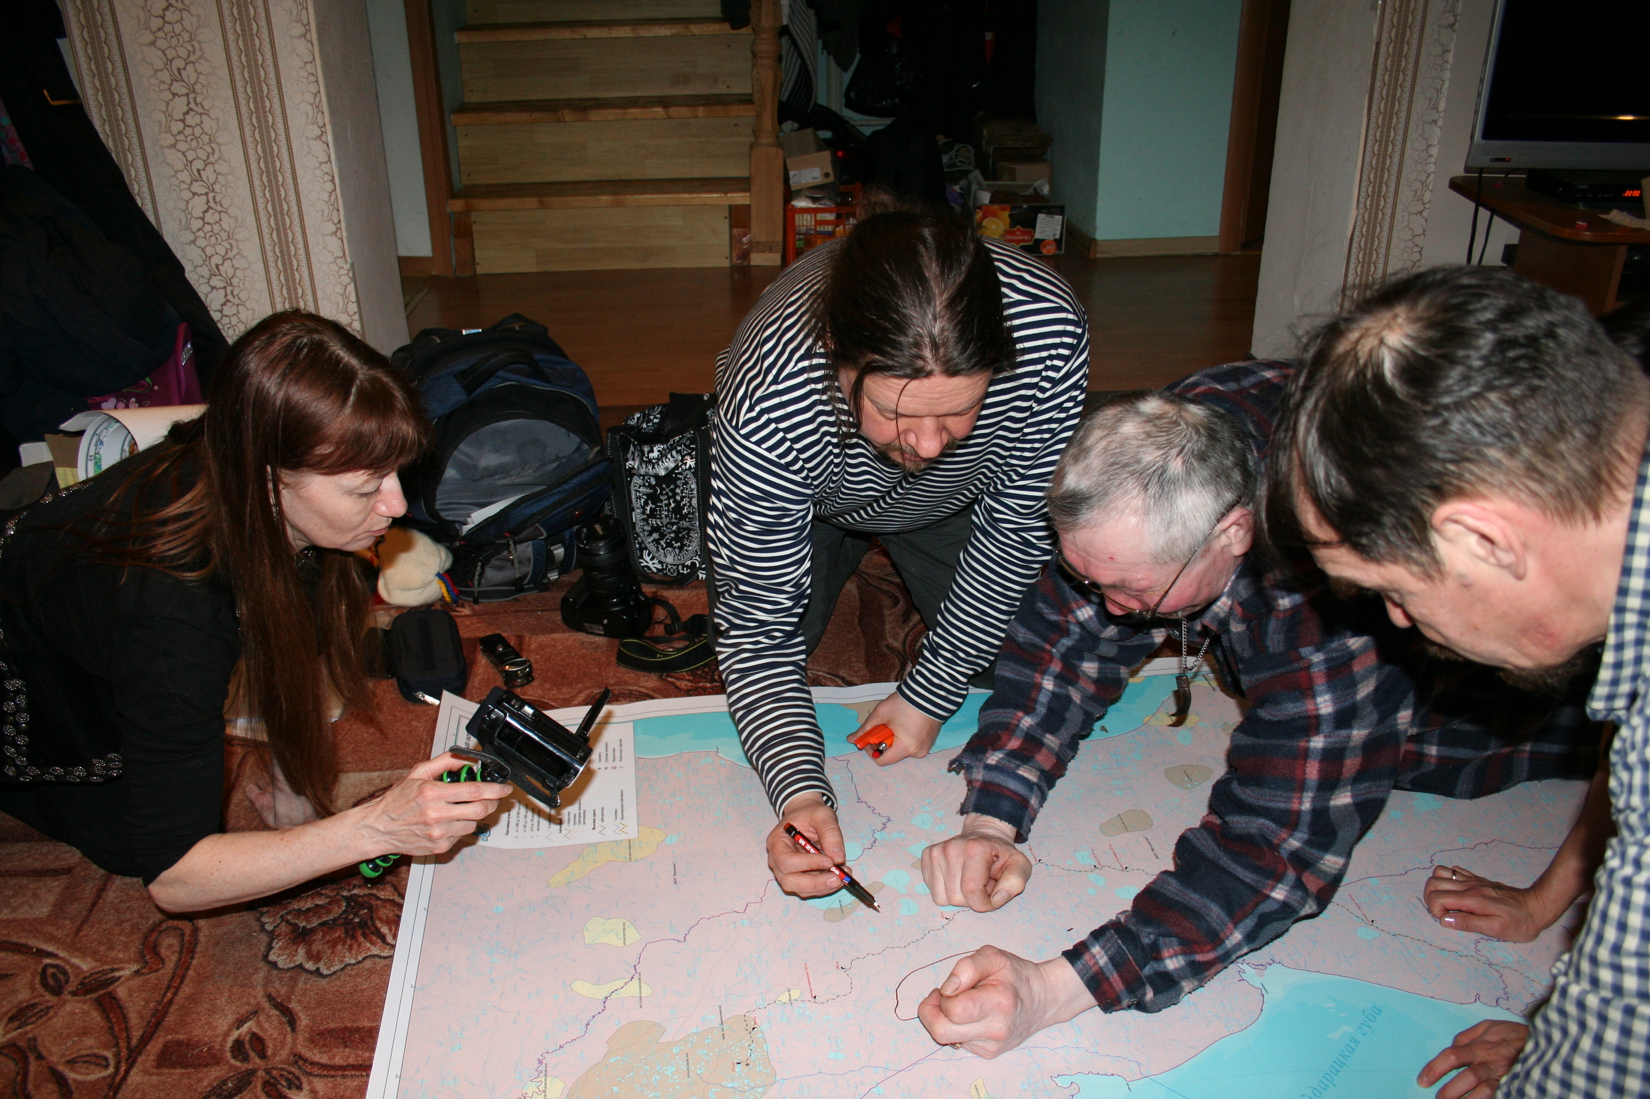
Participatory methods and co-production of knowledge are at the core of CHARTER
Co-documentation of different ways of knowing (focus groups, interviews, workshops…Covid-19 permitting)
Contributing to co-development of local planning & policies
Indigenous scholars included within the consortium
Co-development achieved during project planning
Synthesize existing datasets alongside new fieldwork
Photo: J. Kumpula
Photo: B.C. Forbes
Photo: B.C. Forbes

Slide 8
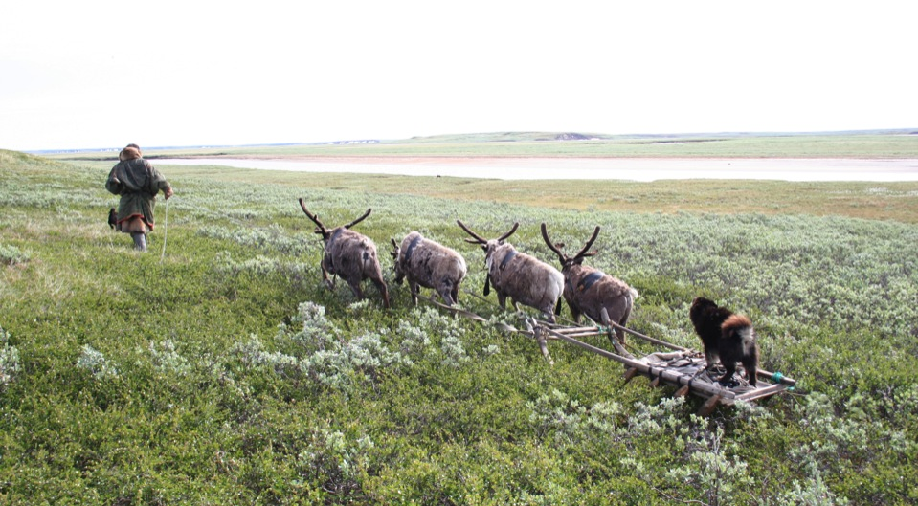
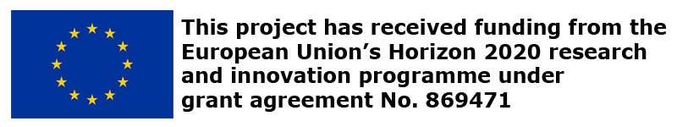

http://www.charter-arctic.org
Thank
you!
Photo: B.C. Forbes

